Slide 1
Practical Kinetics
Exercise 1:
Introduction to Data Analysis in Python
Objectives:
Make some simple graphs and perform some simple calculations with lists
Simulate a first-order kinetic system
Determine when the pre-equilibrium and steady state approximations are appropriate

Slide 2
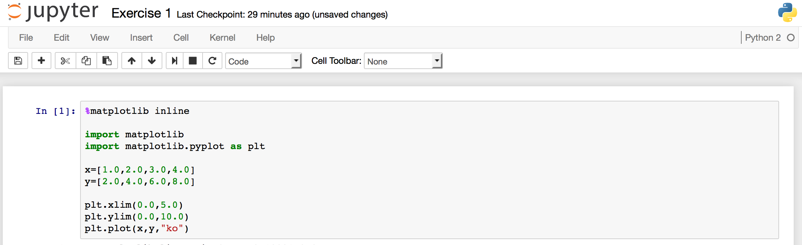
Step 1: Plot a Straight Line
We’ll start by making a very simple graph. Type the following into the first cell:
%matplotlib inline
import matplotlib
import matplotlib.pyplot as plt
x=[1.0,2.0,3.0,4.0]
y=[2.0,4.0,6.0,8.0]
plt.xlim(0.0,5.0)
plt.ylim(0.0,10.0)
plt.plot(x,y,"ko")
Your window should look like this:

Slide 3
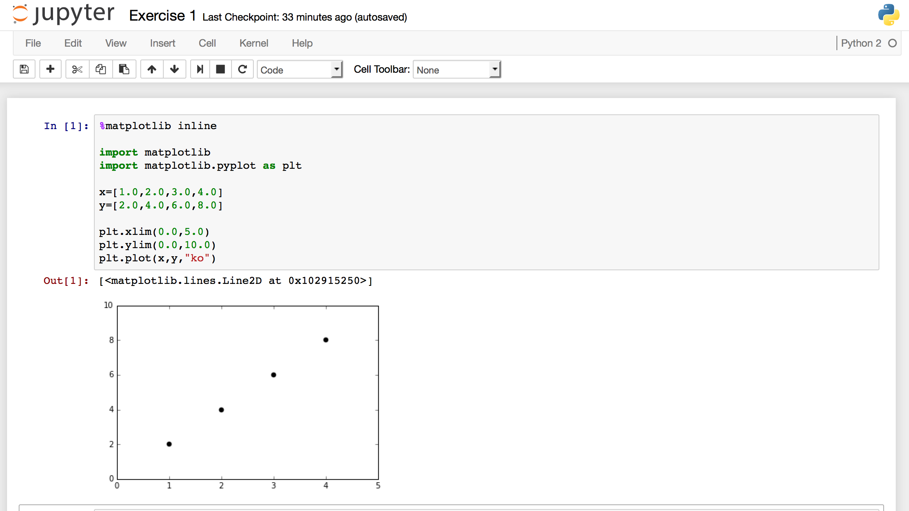
Step 1: Plot a Straight Line
Notice that pressing enter goes to the next line and does not execute anything.
To execute the code, press shift-enter. A plot will appear underneath:

Slide 4
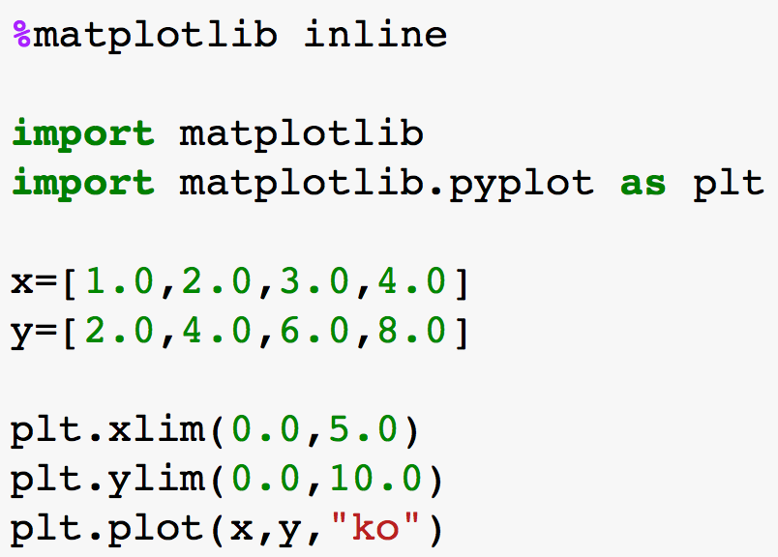
Step 1: Plot a Straight Line
These lines tell Python you
want to make some plots
in your browser window.
These are lists of numbers.
These lines set the x and y
axis limits.
The last line plots y vs. x using black circles (o).
In a new cell, delete the “o” and press shift-enter again to re-evaluate the cell. (That’s a lowercase o, as in “oak.”)

Slide 5
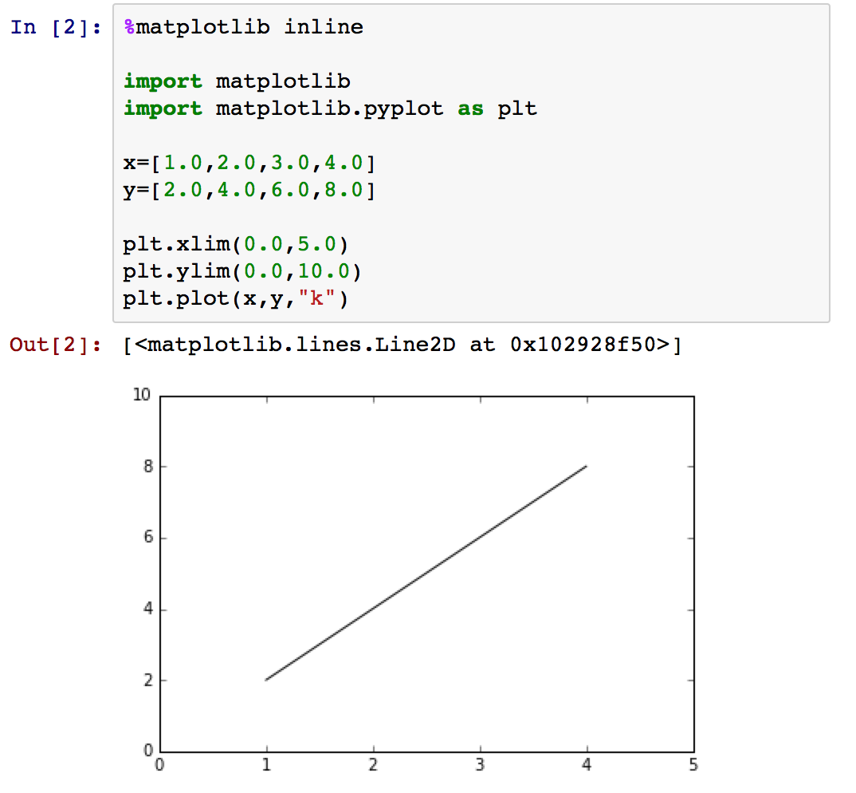
Step 2: Formatting Plots
Without the “o,” just the line is plotted:
You can plot both the line and the points if you wish. Add the original line underneath:
plt.plot(x,y,"ko")
plt.plot(x,y,"k")

Slide 6
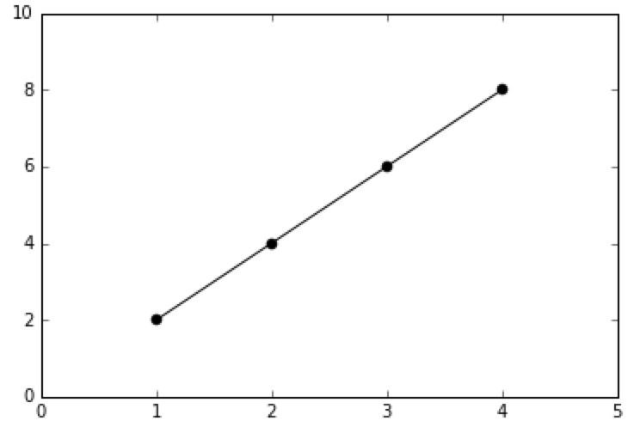
Step 3: Formatting Plots
When multiple plot statements are present, the plots are automatically overlaid:
the format strings
plt.plot(x,y,”ko”)
plt.plot(x,y,”k”)
To customize further, create a format string by combining a color abbreviation with a line style abbreviation:
colors: r = red, b = blue, g = green, k = black
line styles: nothing or - = connect points with straight, solid lines
-- = connect lines with straight, dashed lines
. = mark points with dots
o = mark points with circles
+ = mark points with crosses

Slide 7
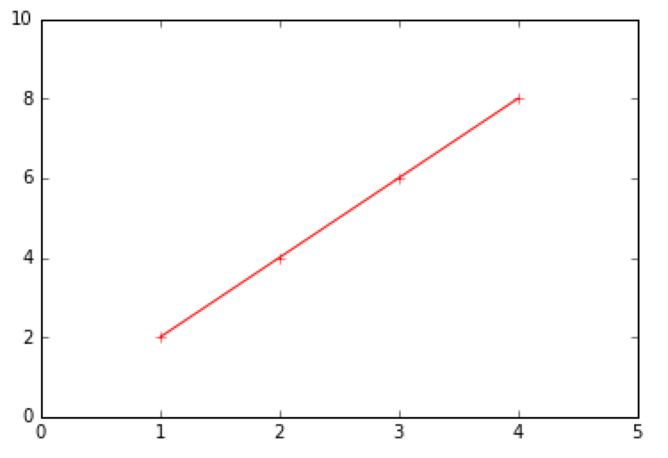
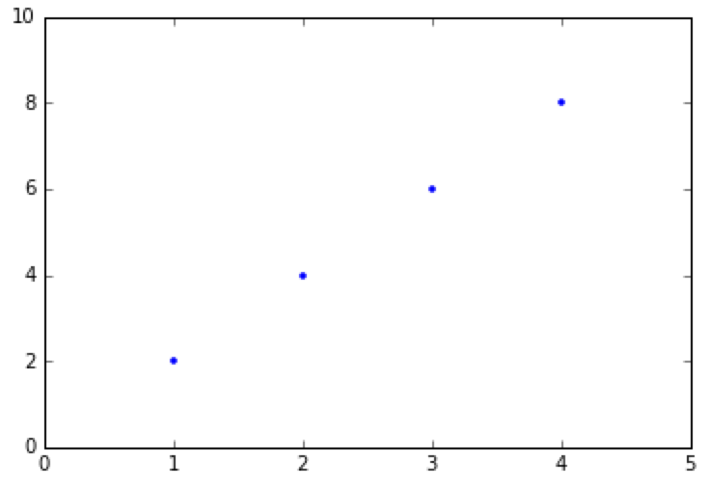
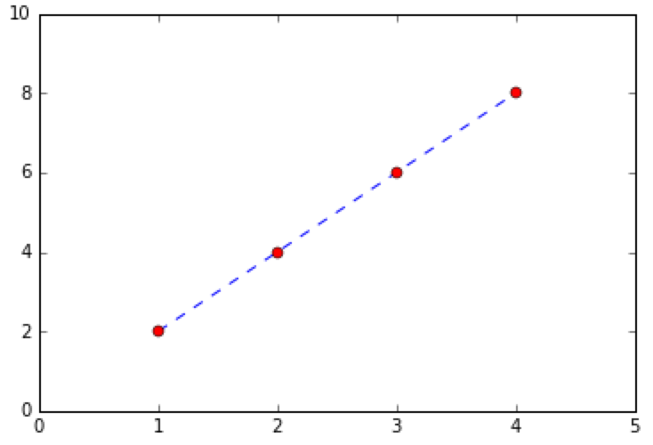
Step 3: Formatting Plots
Here are a few examples:
plt.plot(x,y,”r”)
plt.plot(x,y,”r+”)
plt.plot(x,y,”b.”)
Notice that the color goes first and the line style goes second.
plt.plot(x,y,”b--”)
plt.plot(x,y,”ro”)

Slide 8
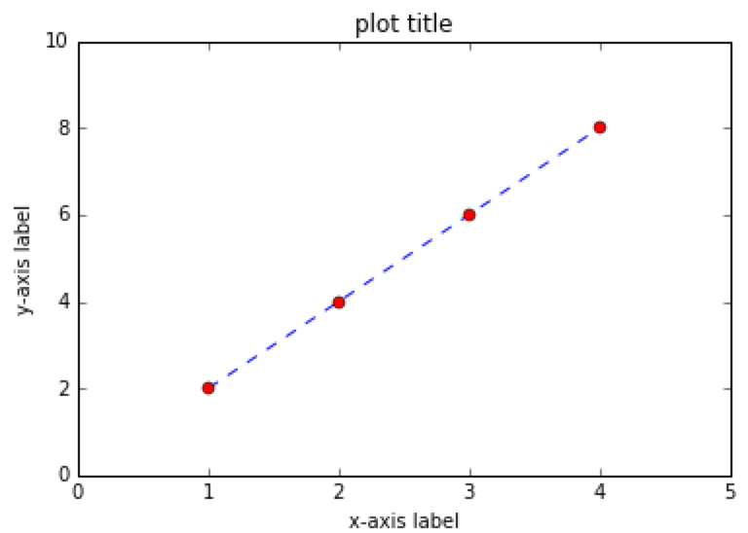
Step 3: Labeling Plots
Try adding the following:
plt.xlabel("x-axis label")
plt.ylabel("y-axis label")
plt.title("plot title")
Note: Further customization of fonts,
legends, line styles, etc. is possible. See:
http://matplotlib.org/users/pyplot_tutorial.html
Saving plots: If you want to save your plot to disk, add a line:
plt.savefig("my_plot.png")
This will save a graphic to the directory you started IPython Notebook in.
You can replace .pdg with .pdf to make PDF files.

Slide 9
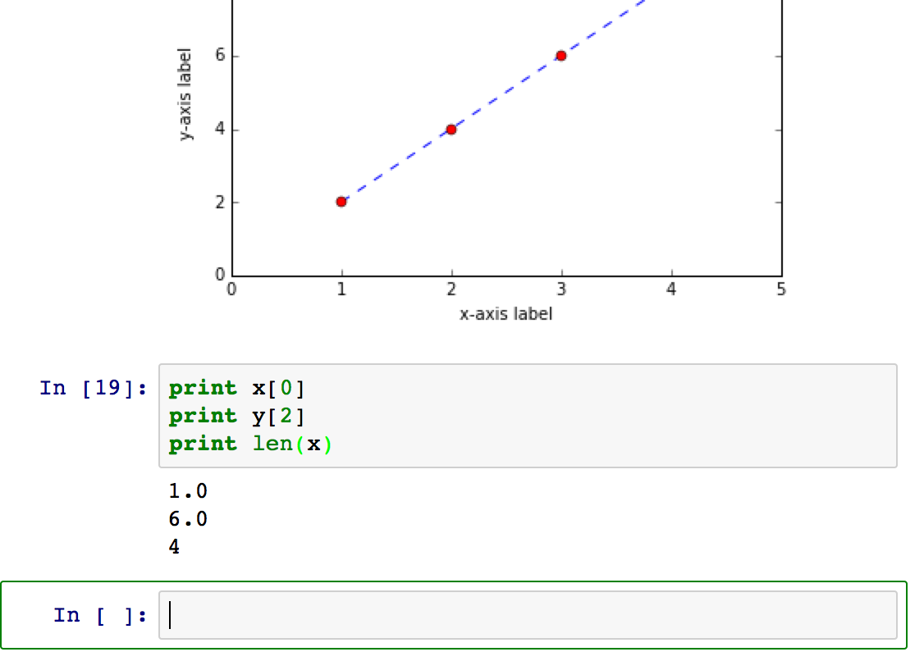
Step 4: Introduction to Lists
In the previous code, we had:
x=[1.0,2.0,3.0,4.0]
y=[2.0,4.0,6.0,8.0]
This makes two lists, one called “x” and another called “y.” You can access lists “by element.” In a new cell, try typing:
print x[0]
print y[2]
print len(x)
Press shift-enter
to evaluate again.
Notice that Python
“remembers” x and y,
even though they were
defined above.
A new cell appears as well:

Slide 10
Step 4: Introduction to Lists
In the previous code, we wrote:
x=[1.0,2.0,3.0,4.0]
y=[2.0,4.0,6.0,8.0]
These are called lists. We’ll deal with lists that contain numbers, but they can contain other things too.
Each element has an index:
x=[1.0, 2.0, 3.0, 4.0]
Notice that the numbering starts at 0, not 1.
You can access each element directly:
print x[0]
1.0
element 1
element 3
element 0
element 2

Slide 11
Step 4: Introduction to Lists
The symbol x is the name of the list:
x=[1.0, 2.0, 3.0, 4.0]
To change an element of x:
x[0]=8.0 result:
print x [1.0, 2.0, 3.0, 4.0]
To append to x:
x.append(5.0) result:
print x [8.0, 2.0, 3.0, 4.0, 5.0]
To find out how many elements x contains:
result:
print len(x) 5
name of list

Slide 12
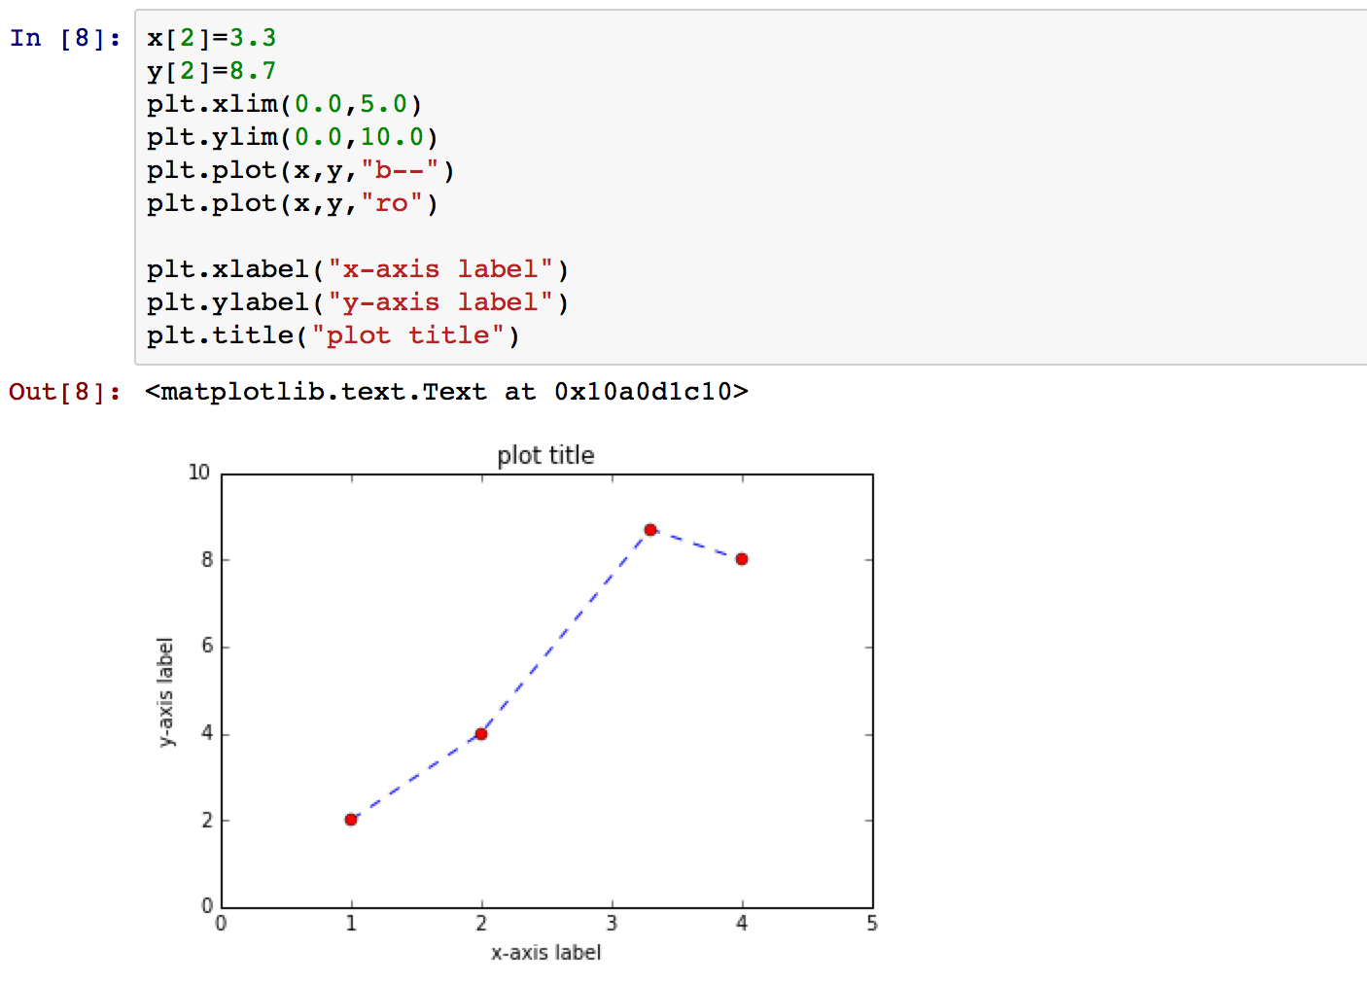
Step 4: Introduction to Lists
In a new cell:
Change the third (index = 2) point to (3.3, 8.7). Re-plot the result.
Notice that the previous plots (not shown here) remain unchanged. However, the lists x and y have now changed in memory. Plotting them again will reflect the changes.

Slide 13
Step 5: List Comprehensions
Instead of entering numbers into lists manually, we can use a mathematical expression.
The simplest is to use the range command:
list1 = range(5) Result:
print list1 [0, 1, 2, 3, 4]
print len(list1) 5
Typing in range(n) returns the numbers from 0 to n, exclusive, as a list.
range(n) = [0, 1, ..., n-1 ]

Slide 14
Step 5: List Comprehensions
We can use range to generate more complicated lists:
list1 = range(5)
list1 = [0, 1, 2, 3, 4]
list2 = [ i*2 for i in list1 ] Result:
print list2 [0, 2, 4, 6, 8]
This is called a list comprehension. In English, this means:
“Take each item in list1, one at a time, and call it i. Multiply i by 2 and put the result in list2.”
Taking items one at a time from a list is called iteration.

Slide 15
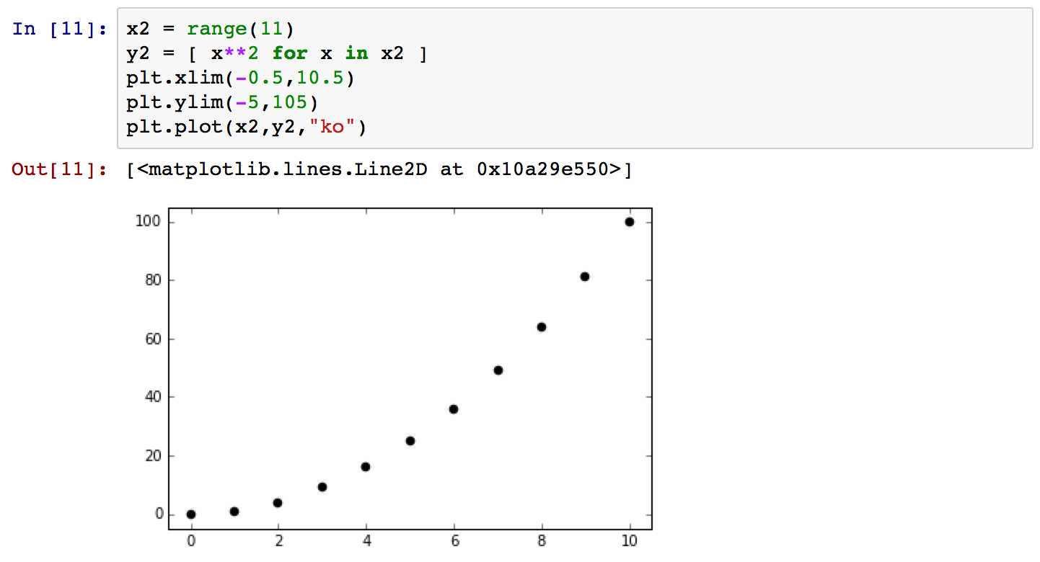
Step 5: List Comprehensions
In a new cell, plot the function y=x² from 0 to 10 using a list comprehension.
Notice that we need range(11), not range(10). x**2 means x raised to the power of 2 in Python.

Slide 16
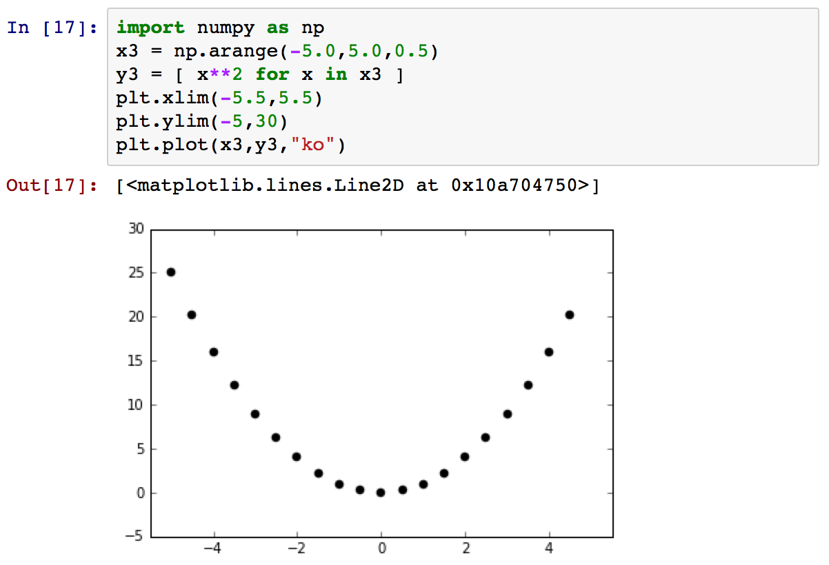
Step 5: List Comprehensions
What if we wanted to plot from –5 to +5, every 0.5? Instead of range, we need a more generalized function called np.arange:

Slide 17
Step 5: List Comprehensions
import numpy as np
This loads the NumPy library. A “library” is a collection of code that has
been written by someone else to perform common tasks.
To refer to a NumPy function instead of a regular Python function,
we need to preface the function’s name with np.
sqrt (regular Python)
np.sqrt (numpy)
np.arange(-5.0, 5.0, 0.5)
“Fill a list with the numbers from –5 to +5 every 0.5.” Just like with the
range function, the last point is not included.
The general syntax is:
np.arange(start, stop, stepsize)

Slide 18
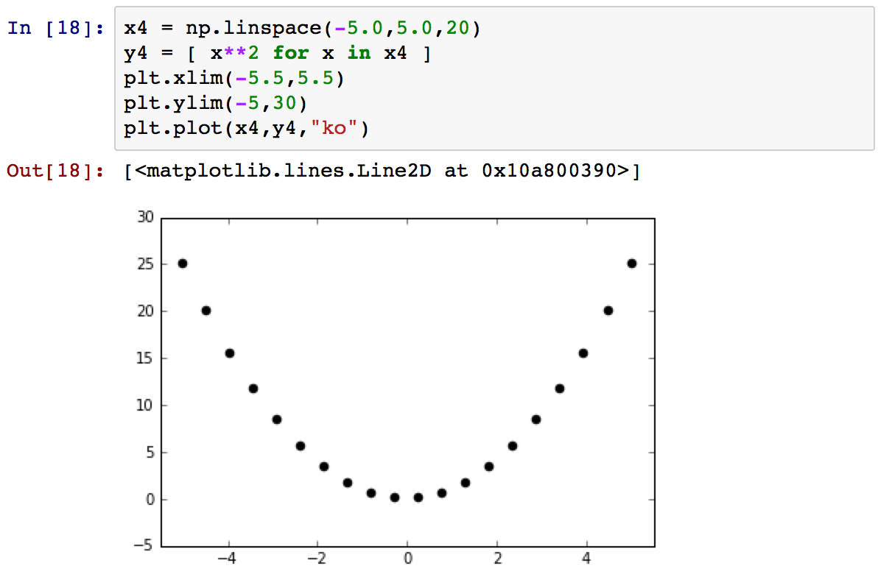
Step 5: List Comprehensions
If you wanted to fill the range from –5 to +5 evenly with 20 points, you can use np.linspace:
Note that with np.linspace, the last point is included.

Slide 19
Step 6: First-Order Kinetics
Recall that for a first-order reaction:
To simulate the timecourse of a reaction, enter the following in a new cell:
from math import exp
import numpy as np
time = np.arange(0.0,10.0,0.1)
initial_concentration = 1.0
rate_constant = 1.0
concentration = [ initial_concentration *
exp(-rate_constant*t) for t in time ]
plt.plot(time, concentration, "k.")
Place this on one line.

Slide 20
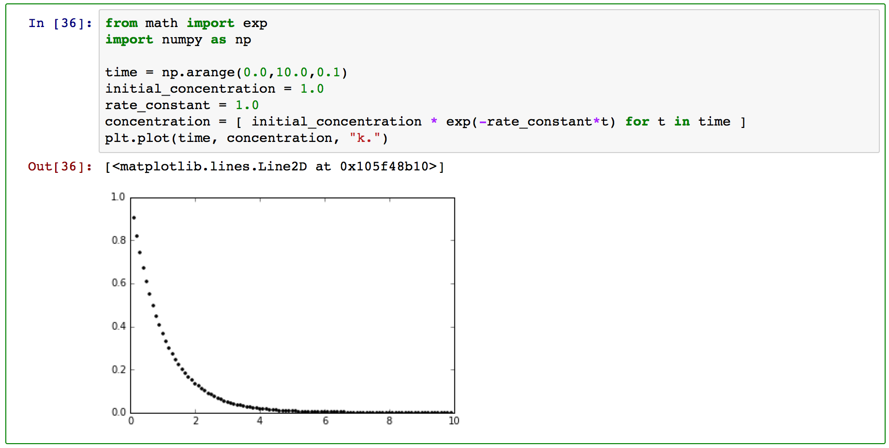
Step 6: First-Order Kinetics
from math import exp
“From now on, whenever I type exp, interpret that to mean the exp function
from the math library.”
We need some mathematical functions.
0 to 10 seconds in 0.1 s steps
the integrated rate law as a
list comprehension

Slide 21
Step 7: Make a Log Plot
Recall that a log plot will show a straight line:
You can perform log calculations with:
from math import log
log_concentration = [ log(conc) for conc in concentration ]
Try this out in a new cell.

Slide 22
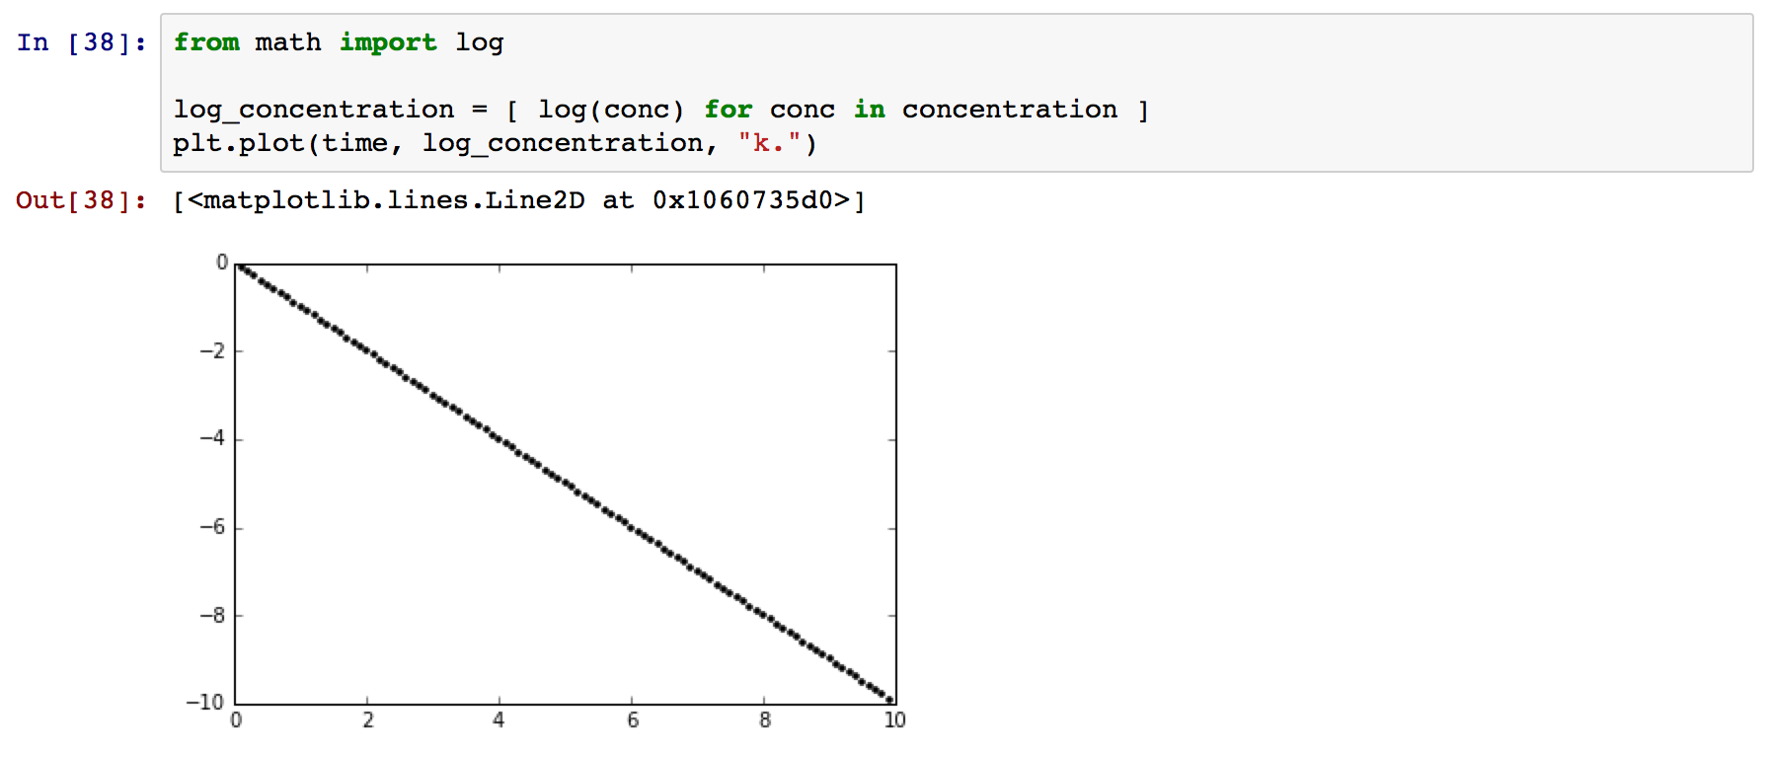
Step 7: Make a Log Plot
This is a straight line with unit negative slope.
The list comprehension “iterates” over concentration to produce a new list:
“Take each value in the concentration list, one at a time, take the logarithm and add it to a new list called log_concentration.”
Note that log means the natural logarithm. You can use log10 for base 10.

Slide 23
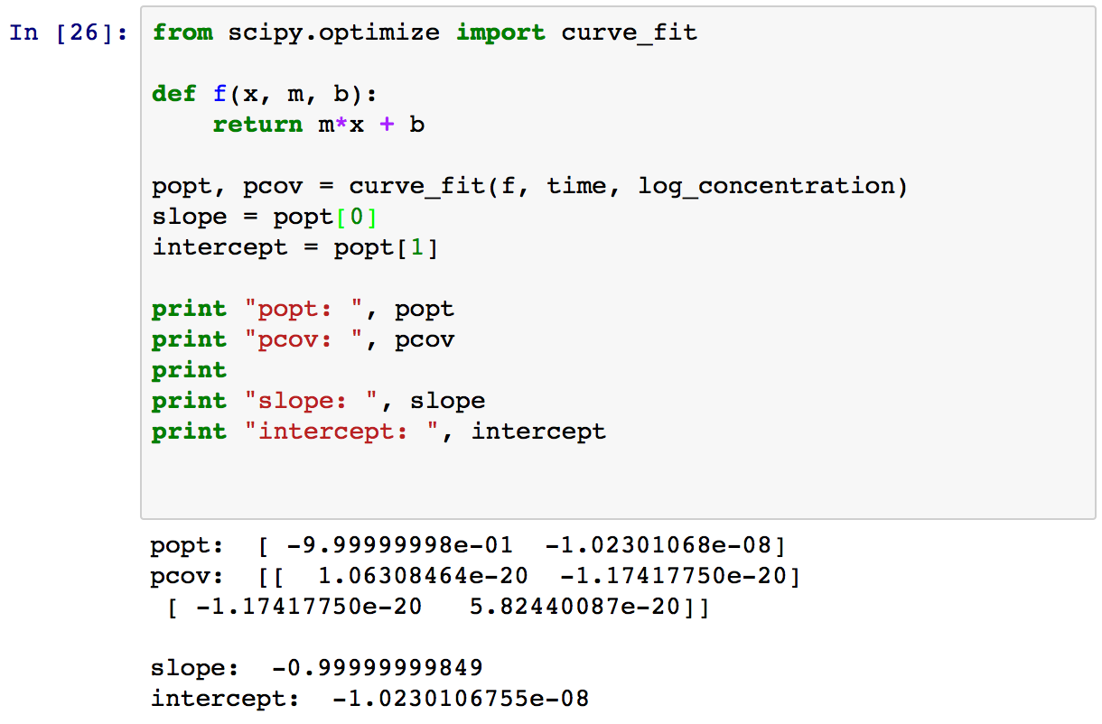
Step 8: Fit a Straight Line
What if you wanted to fit a straight line to get the slope and intercept?

Slide 24
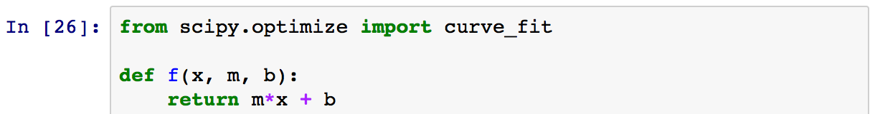
Step 8: Fit a Straight Line
from scipy.optimize import curve_fit
SciPy is a standard Python library that contains many routines for doing scientific computing. In this case, we are importing the curve_fit function from the SciPy optimization library.
def f(x, m, b):
return m*x + b
“Define a function f that takes three parameters: x, m, and b. Return m x x + b whenever f is called.”

Slide 25
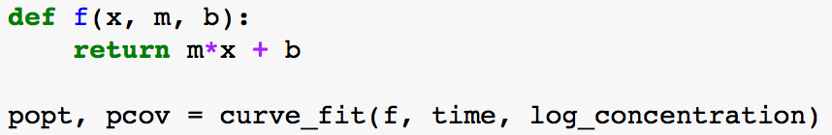
Step 8: Fit a Straight Line
curve_fit is a function in scipy.optimize.
We “call” it with three parameters:
curve_fit(f, time, log_concentration)
f, the functional form of the curve we want to fit
time, the x values
log_concentration, the y values
curve_fit adjusts m and b in f to minimize the sum of squares between f(time, m, b) and log_concentration.

Slide 26
Step 8: Fit a Straight Line
Which parameter is which?
curve_fit determines this by looking at the order in which the parameters are passed to it. That is, the function always comes first, the x values second, and the y values third. The actual names of the parameters are not important.
In the parameter list for the function f(x, m, b), the independent variable must come first. Any subsequent parameters are adjusted to minimize the sum of squares.

Slide 27
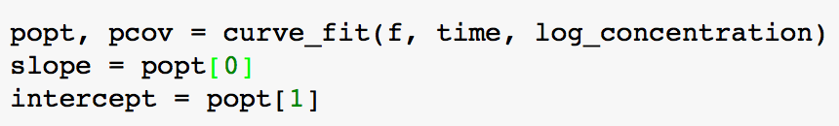
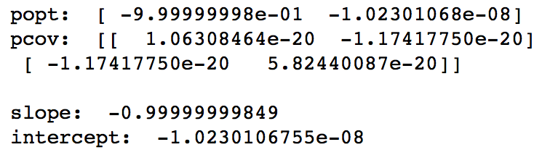
Step 8: Fit a Straight Line
popt, pcov = curve_fit(f, time, log_concentration)
When curve_fit is finished, it places the results in two lists, popt and pcov.
popt contains the optimized values of the parameters, in the same order as defined in f. Thus, the slope m is popt[0] and the intercept b is popt[1].
Technical Note:
pcov contains the (symmetric) covariance matrix for the parameter estimates. The nested square brackets mean that this is really a 2x2 matrix. The diagonal entries pcov[0][0] and pcov[1][1] represent the uncertainties of the slope and intercept, respectively. The off-diagonal entries indicate how the uncertainty in slope and intercept are related. In this case, the uncertainties are very small and meaningless because no error bars were passed to curve_fit.

Slide 28
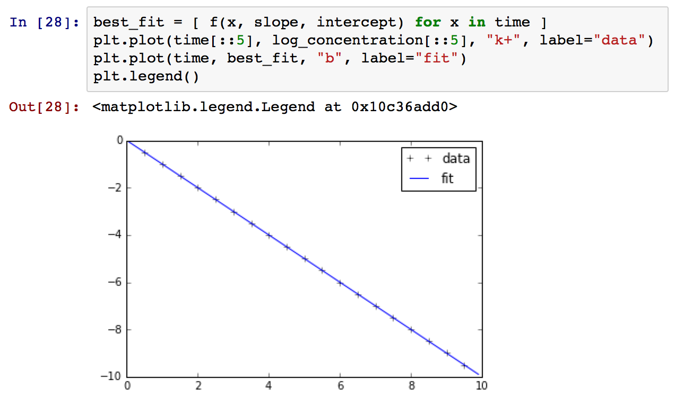
Step 8: Fit a Straight Line
Let’s plot the result:
The fit is perfect because this the data are synthetically generated.
The time[::5] notation tells Python to take every fifth point in the time list and create a new list. I did that so the points aren’t jammed together.

Slide 29
Step 9: Non-Linear Curve Fitting
There is no reason that f must be linear! Instead of fitting log(concentration) vs. time, let’s fit concentration vs. time directly.
In a new cell, type this:
def f2(t, initial_concentration, k):
return initial_concentration*np.exp(-k*t)
popt, pcov = curve_fit(f2, time, concentration)
fitted_initial_concentration = popt[0]
fitted_k = popt[1]
print "fitted initial concentration:", fitted_initial_concentration
print "fitted rate constant:", fitted_k
best_fit2 = [ f2(t, fitted_initial_concentration, fitted_k) for t in time ]
plt.plot(time[::5], concentration[::5], "k+", label="data")
plt.plot(time, best_fit2, "b", label="fit")
plt.legend()
Technical Note:
We need np.exp instead of exp because the latter does not work on arrays.

Slide 30
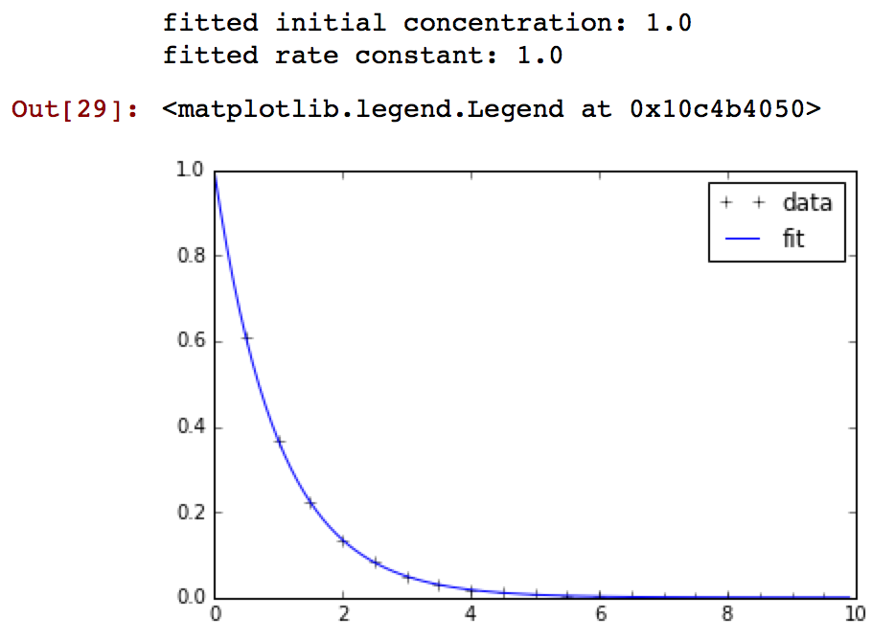
Step 9: Non-Linear Curve Fitting
Of course, the fit is perfect and the parameters are exactly recovered:
Technical Notes: The initial_concentration variable inside f2 is shadowed, meaning that its value is local the scope of the function. It is not the same as the initial_concentration variable defined in previous cells. You can think of it as a dummy variable that disappears as soon as the f2 evaluates.

Slide 31
Step 10: The Two Step System
There are three ways to treat this system:
1. Pre-Equilibrium Approximation
Assume that the ratio K = [B]/[A] is maintained at its thermodynamic value,
k₁/k_{–1}. This is valid if the subsequent rate constant, k₂, is relatively slow.
2. Steady State Approximation
More generally, we can assume that d[B]/dt ≈ 0. More precisely, we assume
that [B] changes much more slowly than [C]. Put another way, we assume
that the amount of [B] is determined kinetically, rather than thermodynamically.
This is valid if k₂ is relatively fast.
3. Differential Equations
If we solve the differential equations exactly, we can see when the pre- equilibrium and steady state approximations are valid.

Slide 32
Step 10: The Two Step System
The integrated rate laws for this system are:
The derivation uses the Laplace Transform (J. Chem. Educ. 1999, 76, 1578). I have presented the solution into a more convenient form (Chemical Kinetics and Catalysis Notes 2011, Professor Clark Landis, University of Wisconsin-Madison).

Slide 33
Step 10: The Two Step System
In a new cell, compute the timecourse of the following reaction:
Simulation Parameters:
k_1 = 10.0 k_minus1 = 100.0
k_2 = 0.1
A_initial = 1.0
Plot from 0.0 to 5.0 seconds.
If this looks hard, don’t worry, because we’ll do it step by step.

Slide 34
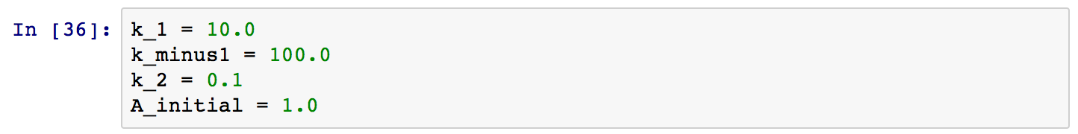
Step 10: The Two Step System
First, setup some variables:
We can reevaluate this cell later when we want to change the rate constants.
Next, calculate:
None of these variables depends on time, so it makes sense to calculate them ahead of time.

Slide 35
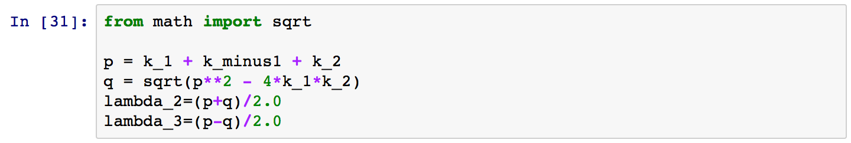
Step 10: The Two Step System
Note that we needed to import the math.sqrt function.

Slide 36
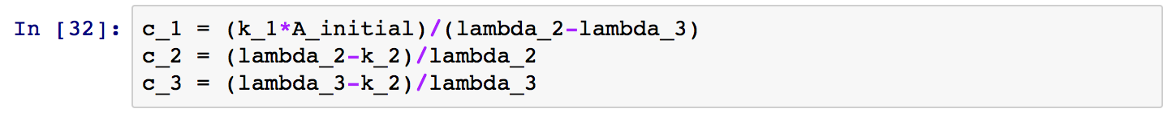
Step 10: The Two Step System
Examining the expressions for [A] and [B], we find that there are constants that also do not depend on time. I highlighted one of them.
Let’s define those, too:
Remember, if we change the rate constants later, we’ll have to re-evaluate all of these cells to update everything.

Slide 37
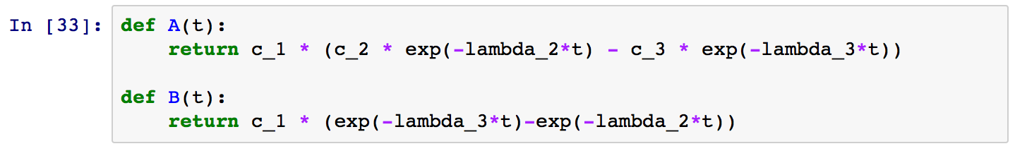
Step 10: The Two Step System
Now, let’s create functions for [A] and [B]. We will calculate [C] by mass balance later.
Note that these functions depend on variables that are outside their scope. For example, c_1 appears inside A(t) even though it is not defined there. This is perfectly acceptable in Python.

Slide 38
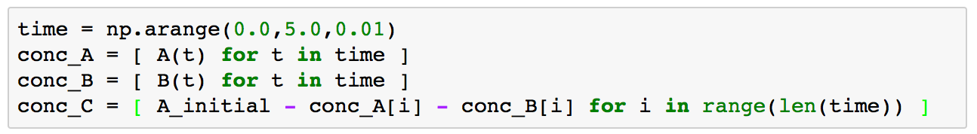
Step 10: The Two Step System
Now we need to run the simulation.
First, we fill up the time list with values from 0.0 to 5.0 in steps of 0.01.
Then, we iterate over time. For each value t in time, we call the function A to get the value A(t). These values are placed, one at a time, in conc_A.
We do the same thing for [B]. For [C], we use mass balance.

Slide 39
Step 10: The Two Step System
Step by step:
len(time) returns the number of time points (i.e., the number of elements in time)
range(len(time)) returns a list [0, 1, ..., len(time)-1]. We can use this to iterate over each list in parallel, since each list has the same number of elements.
Finally, conc_C = [ A_initial – conc_A[0] – conc_B[0],
A_initial – conc_A[1] – conc_B[1],
...,
A_initial – conc_A[n-1] – conc_B[n-1] ]
where n = len(time).
In English, this is the total concentration minus [A] minus [B] for every point in time.

Slide 40
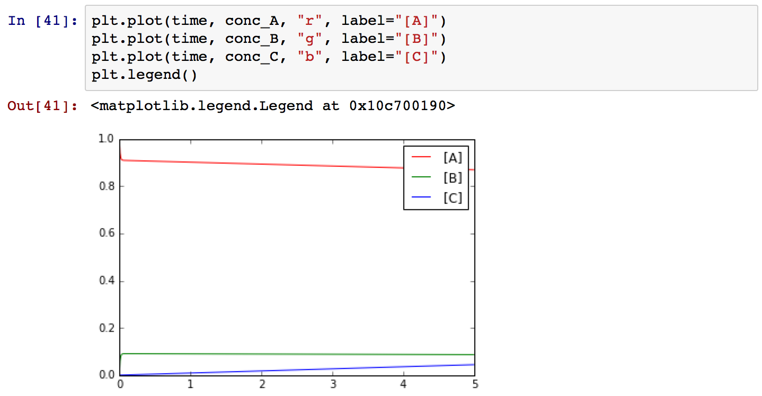
Step 10: The Two Step System
Here is the plot of the result:
Would you call this pre-equilibrium, steady state, or neither?

Slide 41
Step 11: Pre-Equilibrium or Steady State?
Plot the ratio of [B]/[A] over the course of the reaction to find out.
On one line, type:
conc_ratio = [ conc_B[i] / conc_A[i] if conc_B[i] > 0.0 else 0.0 for i in range(len(time)) ]
This divides [B]/[A] for each point in time. The expression:
conc_B[i] / conc_A[i] if conc_B[i] > 0.0 else 0.0
means that we should only divide if [A] ≠ 0.
The “foreach” expression
for i in range(len(time))
iterates over [0, 1, ..., len(time)-1], the indices of conc_A and conc_B.

Slide 42
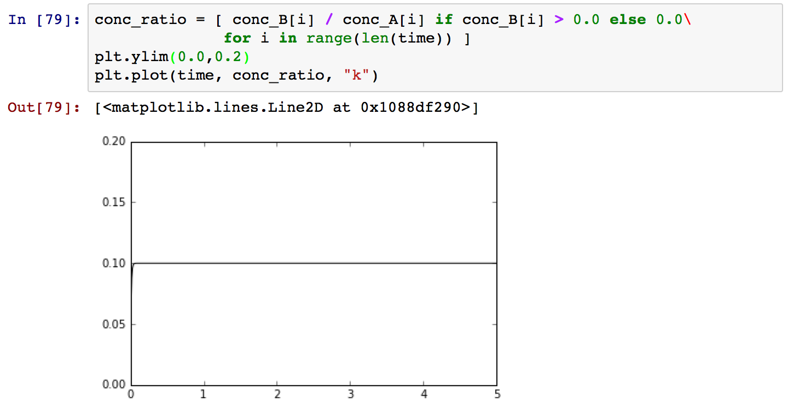
Step 11: Pre-Equilibrium or Steady State?
The ratio is 1:10 for most of the reaction. Recall, k_1 = 10.0,
k_minus1 = 100.0, k_2 = 0.1. The thermodynamic ratio is k₁/k_{–1} = 0.1, so this is pre-equilibrium. This happens when k₂ is slow relative to k₁ and k₋₁.
(This backslash lets me put the expression on one line. On your computer, you can just put the whole expression on one line.)

Slide 43
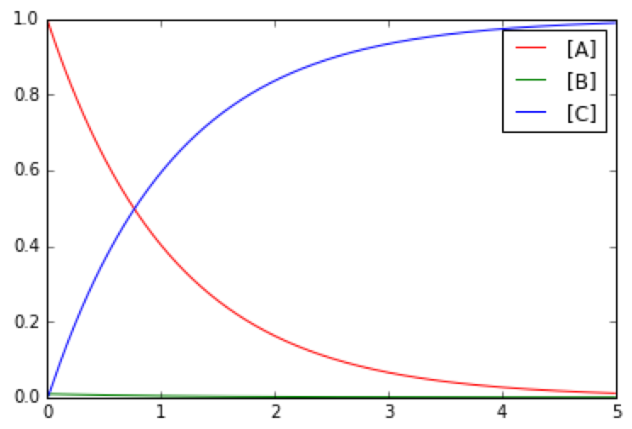
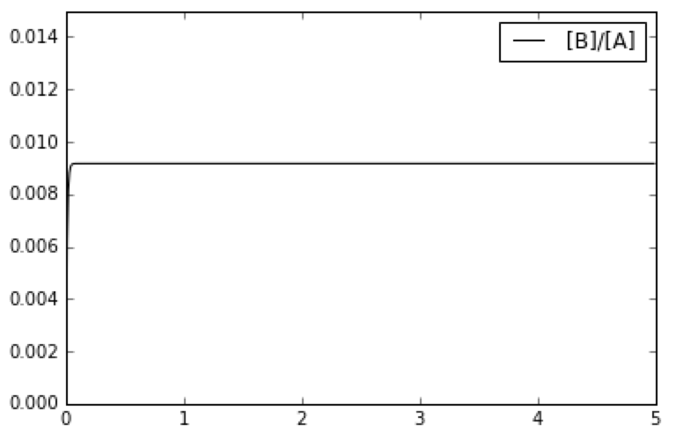
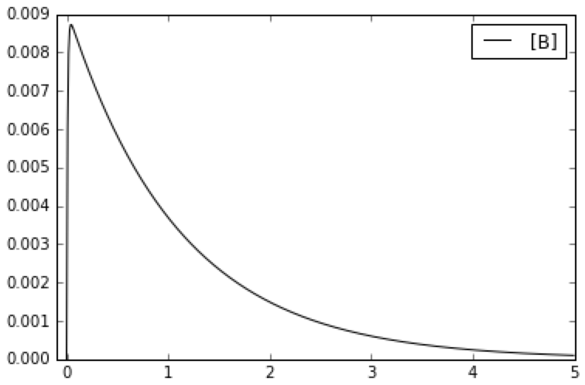
Step 11: Pre-Equilibrium or Steady State?
What if k₂ is fast? Re-run the simulation with:
k_1 = 1.0 k_minus1 = 10.0 k_2 = 100.0
This is steady-state:
In this case, [B]/[A] = 1/(10+100) = 0.009, matching the figure above. This is the “kinetic equilibrium” value.

Slide 44
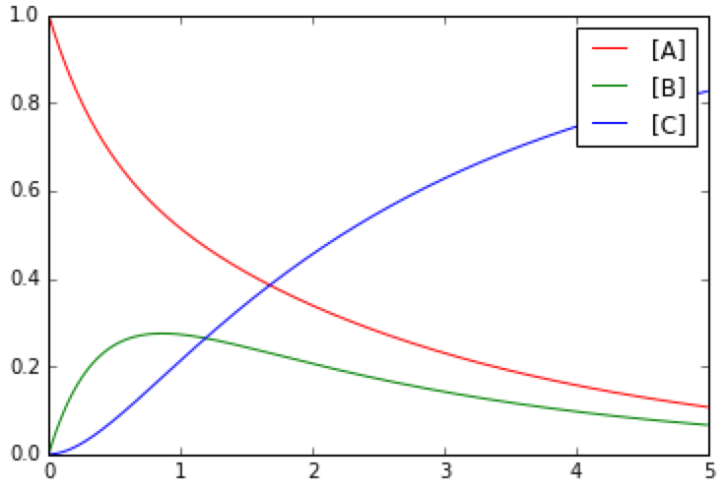
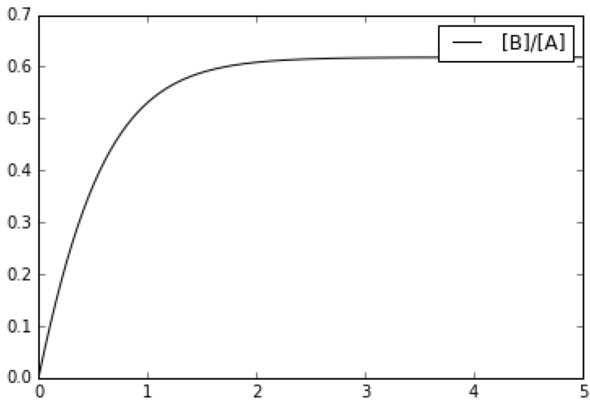
Step 12: Competitive Rates
To conclude this exercise, let’s examine the case where all the rate constants are set to 1.0:
The plot on the right shows that neither the pre-equilibrium nor steady state conditions apply until late in the reaction. This scenario is rare.

Slide 45
Summary
Congratulations! You now know how to perform simple kinetic analyses in Python!
Here are some short code fragments that summarize what you learned:
Plotting
# comments start with a hashtag
# import libraries
%matplotlib inline
import matplotlib
import matplotlib.pyplot as plt
# multiple plot statements will
# automatically overlay
plt.plot(x,y,"ko”,label=“abc”)
plt.plot(x2,y2,”b”,label=“def”)
# set plot boundaries
plt.xlim(0.0,5.0)
plt.ylim(0.0,10.0)
# add a legend
plt.legend()
# add plot labels
plt.xlabel("x-axis label")
plt.ylabel("y-axis label")
plt.title("plot title”)
# save the plot
plt.savefig("my_plot.png”)
For a more in-depth introduction, I recommend:
https://www.codecademy.com/learn/python
More self-guided tutorials are available at:
http://learnpythonthehardway.org/book/index.html
A good reference for NumPy and SciPy is:
http://www.engr.ucsb.edu/~shell/che210d/numpy.pdf
# fitting

Slide 46
Summary
Lists
# basic list operations
list1 = [1.0, 3.0, 7.0]
list1[0] = 1.0
list1[1] = 3.0
list1[2] = 7.0
len(list1) = 3
# to
# range(n) gives 0, 1, ..., n-1
list2 = [ i for i in range(5) ]
list2 = = [0, 1, 2, 3, 4]
# to take every n-th item
list3 = [ i for i in range(10) ]
list3[::5] = [0, 2, 4, 6, 8]
# avoid dividing by zero
# with a ternary expression
list4 = [0.0, 2.0, 4.0]
list5 = [ 1.0 / i if i > 0.0 else 0.0 for i in list3 ]
list5 = [0.0, 0.5, 0.25]
Math
# use “.0” after numbers
# addition, subtraction
1.0+2.0, 4.0-2.0
# multiplication, division
2.0*3.0, -4.0/5.0
# exponents
x ** y # x raised to the y
from math import exp, log
import numpy as np
# exponentials
exp(x) or np.exp(x)
# logarithms
log(x) or np.log(x)
# linearly spaced values
np.arange(start,stop,stepsize)
np.linspace(start,stop,number_of_steps)

